Slide 1
CAP5415
Computer Vision
Yogesh S Rawat yogesh@ucf.edu HEC-241

Slide 2
Administrative details

Slide 3
Office hours
You are encouraged to use office hours
Questions
Doubts, etc…
Email for prior appointment
yogesh@ucf.edu
taoyang1122@knights.ucf.edu
Otherwise, will have to wait in the waiting room (100 students in class)

Slide 4
Questions?

Slide 5
Linear Algebra Basics
Lecture 2

Slide 6
Outline
Vectors
Operations
Matrix
Operations
Transformations
Scaling
Rotation
Translation
Singular value decomposition

Slide 7
Outline
Vectors
Operations
Matrix
Operations
Transformations
Scaling
Rotation
Translation
Singular value decomposition

Slide 8
Vector
Scalar: 𝑥 ∈ ℝ
Vector: 𝒙 ∈ ℝ^{𝑁}
Row Vector v ∈ ℝ^{1×𝑛}
𝒙 =
𝑥₁ 𝑥₂ ⋯ 𝑥_{𝑛}
𝑥₁
𝑥₂
⋮
𝑥_{𝑛}
Column vector v ∈ ℝ^{𝑛×1} : 𝒙 =
=
𝑥₁ 𝑥₂ ⋯
_{𝑥𝑛} 𝑻
Transpose

Slide 9
Vectors - use
Store data in memory
Feature vectors
Pixel values
Any other data for processing
Any point in coordinate system
Can be n dimensional
𝑥₁ 𝑥₂ 𝑥₃
Difference between two points
𝑥₁ − 𝑦₁ 𝑥₂ − 𝑦₂ 𝑥₃ − 𝑦₃
𝑦
1
𝑦 𝑦
2
3

Slide 10
Outline
Vectors
Operations
Matrix
Operations
Transformations
Scaling
Rotation
Translation
Singular value decomposition

Slide 11
Vector operations
Norm – size of the vector
1
x = ⎛∑ a
p ⎞ ^{p}
p-norm
⎜
⎟
⎠
p ≥ 1
p
⎝ i
i
⎞1/ 2
⎛
2 ⎟
Euclidean norm
x = ⎜∑ a
2
⎝ i
i
⎠
₌ ⎛ _{a} ⎞
x ⎜∑ ⎟
L1-norm
1
i
⎝ i ⎠

Slide 12
Vector operations
Inner product (dot product)
Scalar number
Multiply corresponding entries and add
𝑦₁
𝑦₂
⋮
𝒙^{𝑇} 𝒚 =
𝑥
𝑥 ⋯ 𝑥
= σ^{𝑛} 𝑥 𝑦
𝑘 𝑘 𝑘
1
2
𝑛
^{𝑦}𝑛

Slide 13
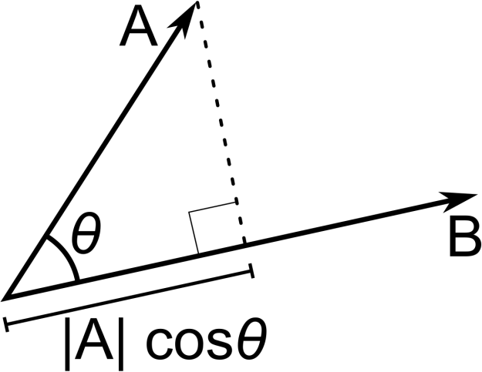
Vector operations
Inner product (dot product)
_{= σ}𝑛 _{𝑥}𝑖
𝑘 𝑘
2
= squared norm of 𝒙
𝒙^{𝑇}𝒙
𝑖
𝑖
𝑖
x.y is also |x||y|cos(angle between x and y)
If B is a unit vector, A.B gives projection of A on B

Slide 14
Vector operations
Outer product
𝑥^{𝑖} 𝑥^{𝑗} 𝑥^{𝑖} 𝑥^{𝑗} ⋯
⋯
⋱
⋯
𝑥^{𝑖} 𝑥^{𝑗}
1
1
1
2
1 𝑛
𝑇 𝑥^{𝑖} 𝑥^{𝑗}
𝑥^{𝑖} 𝑥^{𝑗}
𝑥^{𝑖} 𝑥^{𝑗}
𝒙_{𝑖}𝒙_{𝑗} =
2
⋮
1
2
⋮
2
2
2
(a matrix)
⋮
_{𝑥𝑖 𝑥}𝑗
𝑥^{𝑖} 𝑥^{𝑗}
𝑥^{𝑖} 𝑥^{𝑗}
𝑛
1
𝑛
2
𝑛
𝑚

Slide 15
Outline
Vectors
Operations
Matrix
Operations
Transformations
Scaling
Rotation
Translation
Singular value decomposition

Slide 16
Matrix
Array 𝑨 ∈ ℝ^{𝑚×𝑛} of numbers with shape m by n,
m rows and n columns
^{𝑎}11 ^{𝑎}12
^{𝑎}21 ^{𝑎}22
⋮ ⋮
^{𝑎}𝑚1 ^{𝑎}𝑚2
⋯
⋯
⋱
⋯
^{𝑎}1𝑛
^{𝑎}2𝑛
⋮
𝑨 =
^{𝑎}𝑚𝑛
A row vector is a matrix with single row
A column vector is a matric with single column

Slide 17


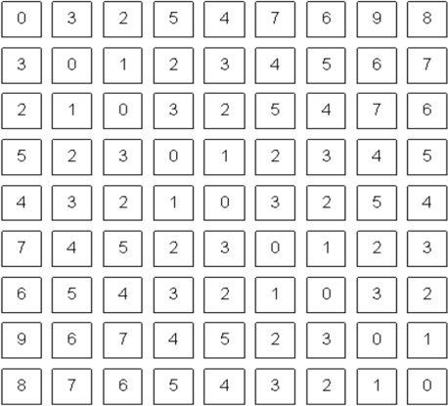
Matrix - use
Image representation – grayscale
One number per pixel
Stored as nxm matrix

Slide 18
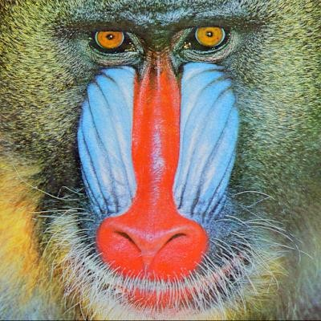
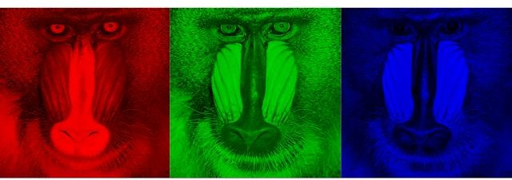
Matrix - use
Image representation – RGB
3 numbers per pixel
Stored as nxmx3 matrix

Slide 19
Outline
Vectors
Operations
Matrix
Operations
Transformations
Scaling
Rotation
Translation
Singular value decomposition

Slide 20
Matrix operations
Addition
𝑎 𝑏
𝑐 𝑑
𝑒 𝑓
𝑔 ℎ
𝑎 + 𝑒
𝑐 + 𝑔
𝑏 + 𝑓
𝑑 + ℎ
+
=
Both matrices should have same shape, except with a scalar
𝑎 𝑏
𝑐 𝑑
𝑎 + 2
𝑐 + 2
𝑏 + 2
𝑑 + 2
+ 2 =
Same with subtraction

Slide 21
Matrix operations
Scaling
𝑎 𝑏
𝑐 𝑑
𝑠x𝑎
𝑠x𝑐
𝑠x𝑏
𝑠x𝑑
𝑠 x
=
Hadamard product
𝑎 𝑏
𝑐 𝑑
𝑒 𝑓
𝑔 ℎ
𝑎x𝑒
𝑐x𝑔
𝑏x𝑓
𝑑xℎ
⨀
=

Slide 22
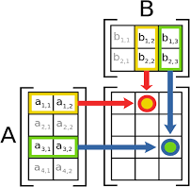
Matrix operation
Matrix Multiplication
Compatibility?
mxn and nxp
Results in mxp matrix

Slide 23
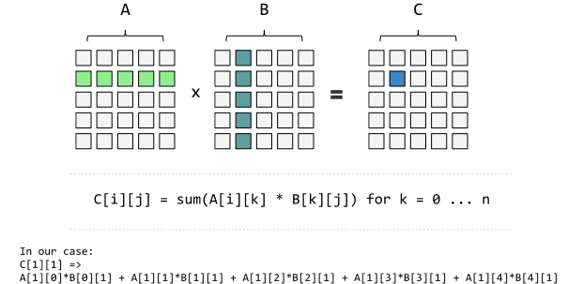
Matrix operation
Matrix Multiplication
Let 𝒂_{𝑖} denote the i-th column of the matrix 𝑨, and
𝒃_{𝑗} denote the j-th column of the matrix B
𝒂₁ 𝒂₂ ⋯
𝒃_{𝒎}
𝑨 = 𝒂𝑛 , and 𝑩 = 𝒃₁ 𝒃₂ ⋯
The product of the two matrices is defined as
𝒂^{𝑇}𝒃₁ | 𝒂^{𝑇}𝒃₂ | ⋯ | 𝒂^{𝑇}𝒃_{𝑚} 1
_{𝑨}𝑇_{𝑩 =} 𝒂^{𝑇}𝒃₁ 𝒂^{𝑇}𝒃₂ ⋯ 𝒂^{𝑇}𝒃_{𝑚} 2 2 2
⋮ 𝒂^{𝑇}𝒃 | ⋮ 𝒂^{𝑇}𝒃 | ⋱ ⋯ | ⋮ 𝒂^{𝑇}𝒃 𝑛 𝑚
1
1
𝑛 1
𝑛 2

Slide 24
Matrix operation
Matrix Multiplication – another interpretation (my favorite)
Let 𝒂_{𝑖} denote the i-th column of the matrix 𝑨, and
𝒃_{𝑗} denote the j-th column of the matrix B.
𝒂₁ 𝒂₂ ⋯
𝑨 = 𝒂𝑛 , and 𝑩 = 𝒃₁ 𝒃₂ ⋯ 𝒃_{𝒎}
The first column of AB
Linear combination of all the columns in A
𝒂_{𝟏}𝑏₁₁ + 𝒂_{𝟐}𝑏₁₂ + … + 𝒂_{𝒏}𝑏_{1𝑛}

Slide 25
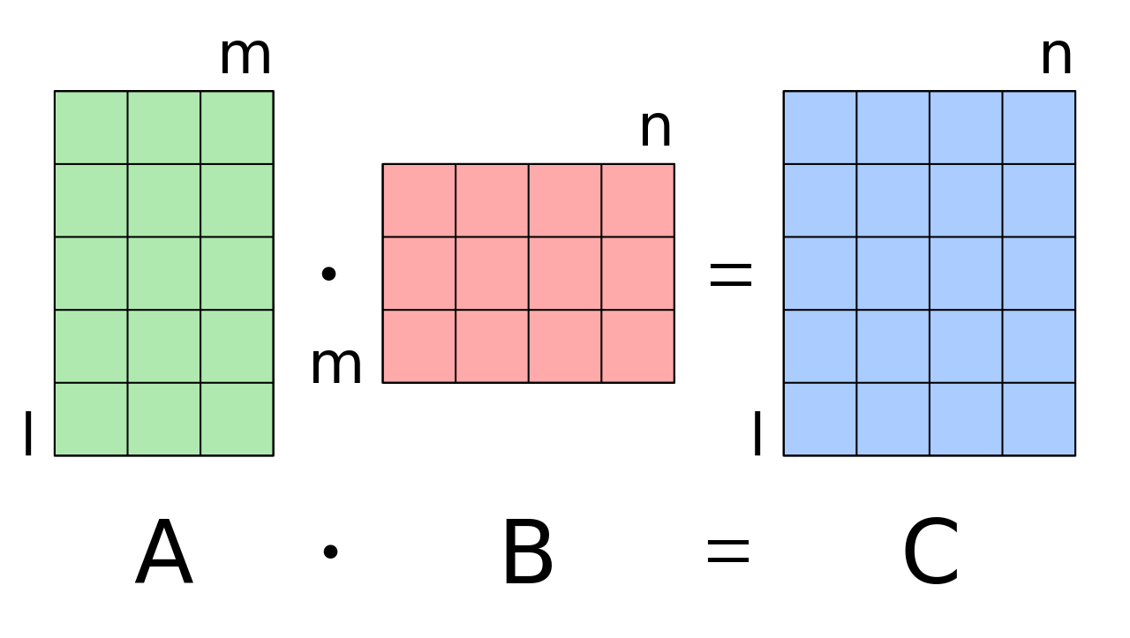
Matrix operation
𝒂_{𝟏}𝑏₁₁ + 𝒂_{𝟐}𝑏₁₂ + … + 𝒂_{𝒏}𝑏_{1𝑛}
Similarly, we can get other columns…

Slide 26
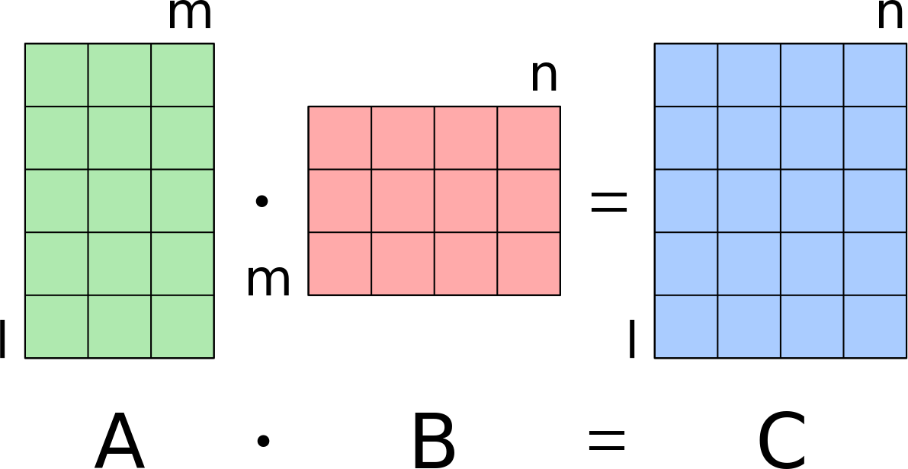
Matrix operation
How about linear combination of all rows of B?
Each row of C = AB is a linear combination of rows of B
𝒃_{𝟏}𝑎₁₁ + 𝒃_{𝟐}𝑎₂₁ + … + 𝒃_{𝒏}𝑎_{𝑛1}

Slide 27
Matrix operation
Transpose
𝑎
𝑎
⋯ 𝑎
⋯
⋱
⋯
11
12
1𝑛
^{𝑎}21 ^{𝑎}22
⋮ ⋮
^{𝑎}𝑚1
^{𝑎}2𝑛
⋮
𝑨 =
^{𝑎}𝑚2
^{𝑎}𝑚𝑛
^{𝑎}11 ^{𝑎}21 ^{⋯ 𝑎}𝑚1
^{𝑎}12 ^{𝑎}22 ^{⋯ 𝑎}𝑚2
⋮ ⋮ ⋱ ⋮
^{𝑎}1𝑛 ^{𝑎}2𝑛 ⋯
𝑨^{𝑇} =
^{𝑎}𝑚𝑛

Slide 28
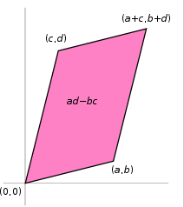
Matrix operation
Determinant
A scalar
𝑎
𝑐 𝑑
For A =
^{𝑏} , det(A) = ad - bc
Represents area of the parallelogram described by the vectors in the rows of the matrix

Slide 29
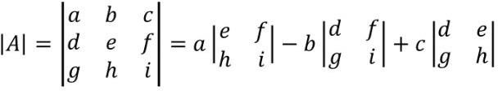
Matrix operation
Determinant
The determinant of a matrix 𝑨 is denoted by
𝑨 = σ^{𝐾}
^{𝑎}𝑖𝑗^{𝐶}𝑖𝑗
𝑖=1
where 𝐶_{𝑖𝑗}is the cofactor of 𝑎_{𝑖𝑗} defined by
𝐶_{𝑖𝑗} = −1 ^{𝑖+1} 𝑴_{𝑖𝑗} , and
𝑴_{𝑖𝑗} is the minor of matrix 𝑨 formed by eliminating row i and column j of 𝑨
Some properties
𝑨𝑩
𝑨𝑩
•
= 𝑨 𝑩
= 𝑩𝑨
_{𝑨}𝑻
= 𝑨

Slide 30
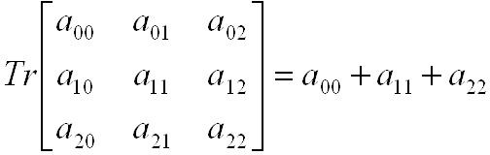
Matrix operation
Trace
Tr(A) = sum of diagonal elements
Properties
tr(AB) = tr(BA)
tr(A + B) = tr(A) + tr (B)

Slide 31
Matrix operation
Inverse
Given a matrix A, its inverse A⁻¹ is a matrix such that
AA⁻¹ = A⁻¹A = I
Inverse does not always exist
Singular vs non-singular
Properties
(A⁻¹) ⁻¹ = A
(AB) ⁻¹ = B⁻¹A⁻¹

Slide 32
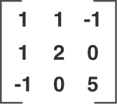
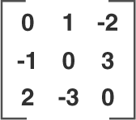
Special matrices
Symmetric matrix
𝑨^{𝑇} = 𝑨
Skew-symmetric matrix
𝑨^{𝑇} = −𝑨

Slide 33
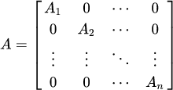
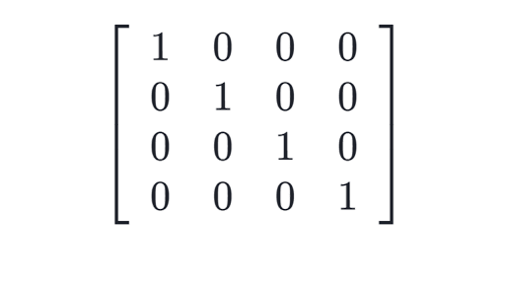
Special matrices
Diagonal matrix
Used for row scaling
Identity matrix
Special diagonal matrix
1 along diagonals
𝑰. 𝑨 = 𝑨

Slide 34
Outline
Vectors
Operations
Matrix
Operations
Transformations
Scaling
Rotation
Translation
Singular value decomposition

Slide 35
Transformation - scaling
Matrices are useful for vector transformations
Matrix multiplication
x’ = Ax
𝑠_{𝑥} 0 _{x}
0 𝑠_{𝑦}
𝑥
𝑦
𝑠_{𝑥}𝑥
𝑠_{𝑦}𝑦
=
Linear combination of columns

Slide 36
Transformation
Rotation
Matrix multiplication to rotate a vector
Rotation matrix
𝑥′ 𝑦′
𝞱
𝑥 𝑦
𝑥′
𝑦′
𝑐𝑜𝑠𝞱
𝑠𝑖𝑛𝞱
− 𝑠𝑖𝑛𝞱
𝑐𝑜𝑠𝞱
𝑥
𝑦
=
x’ = cos𝞱x − sin𝞱y
y’ = sin𝞱x + cos𝞱y

Slide 37
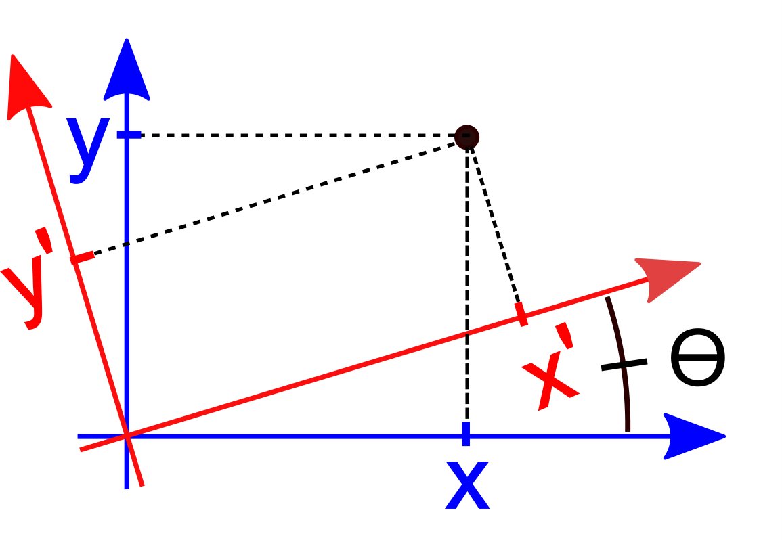
Transformation - rotation
Rotating axis first
Vector v = [x y]
x – projection of v on x axis
y – projection of v on y axis

Slide 38
Transformation - rotation
To rotate the axis, we need to find
x component in new x-axis
y component in new y-axis
Remember vector dot product?

Slide 39
Transformation - rotation
Now we need new x and y axis
x’ = v dot new x-axis
y’ = v dot new y-axis
For rotation of 𝞱
New x-axis = [cos𝞱 , sin𝞱]
New y-axis = [-sin𝞱, cos𝞱]

Slide 40
Transformation - rotation
x’ = v dot new x-axis
y’ = v dot new y-axis
New x-axis = [cos𝞱 , sin𝞱] New y-axis = [-sin𝞱, cos𝞱]
We can form a matrix using new axis
𝑥′
𝑦′
𝑐𝑜𝑠𝞱
−𝑠𝑖𝑛𝞱
𝑠𝑖𝑛𝞱
𝑐𝑜𝑠𝞱
𝑥
𝑦
=

Slide 41
Transformation - rotation
When we rotate the axis to left
We are rotating the vector to right
We can use rotation matrix to rotate the vector

Slide 42
Transformation - rotation
We need new x y axis coordinates
When we rotate the axis right
Updated rotation matrix
𝑥′
𝑦′
𝑐𝑜𝑠𝞱
𝑠𝑖𝑛𝞱
− 𝑠𝑖𝑛𝞱
𝑐𝑜𝑠𝞱
𝑥
𝑦
=

Slide 43
Transformation
Linear combination
𝑎 𝑏 _{x}
𝑐 𝑑
Sufficient for
scaling
rotating and
skew transformations
But no shifting
𝑥
𝑦
𝑎𝑥 + 𝑏𝑦
𝑐𝑥 + 𝑑𝑦
=

Slide 44
Transformation
Linear combination
𝑎 𝑏 0
𝑐 𝑑
0 0 1
𝑥
𝑦
𝑎𝑥 + 𝑏𝑦
0 x
=
𝑐𝑥 + 𝑑𝑦
1
1
Still be able to
scaling
rotation and
skew transformations

Slide 45
Transformation
Homogenous system
𝑎 𝑏 𝑐
𝑑 𝑒
0 0 1
𝑥
𝑦
𝑎𝑥 + 𝑏𝑦 + 𝑐
𝑓 x
=
𝑑𝑥 + 𝑒𝑦 + 𝑓
1
1
We can also perform shifting now
This is called homogenous coordinates

Slide 46
Scaling + rotation + translation
Careful about the order
V’ = (TRS)V
1 0 𝑡_{𝑦}
0 1 𝑡_{𝑥}
0 0 1 0
𝑐𝑜𝑠𝞱
𝑠𝑖𝑛𝞱
− 𝑠𝑖𝑛𝞱 0
𝑐𝑜𝑠𝞱 0
0 1 0
𝑠_{𝑥} 0 0 𝑥
0 𝑠_{𝑦} 0 x 𝑦
0
₁ 1

Slide 47
Outline
Vectors
Operations
Matrix
Operations
Transformations
Scaling
Rotation
Translation
Singular value decomposition

Slide 48
Linear independence
Linear independence
𝒙₁, 𝒙₂ ⋯ , 𝒙_{𝑀} is a set of linearly independent vectors provided
𝑎₁𝒙₁ + 𝑎₂𝒙₂ + ⋯ + 𝑎_{𝑀}𝒙_{𝑀} = 𝟎 ⇒ 𝑎₁ = 0 = 𝑎₂= 𝑎_{𝑀}
In other words, none of the vectors can be expressed as a linear combination of the other vectors
Each vector is perpendicular to every other vector
For example, axis in cartesian coordinate system

Slide 49
Intuition
In terms of features
Person recognition – [height, hair color, weight, specs, eye color, etc.]

Slide 50
Matrix factorization
Singular value decomposition (SVD)
A = UΣV^{T}
If A is mxn matrix, then
U will be mxm,
Σ will be mxn, and
V^{T} will be nxn
U and V are unitary matrices
Each column is a unit vector
Σ is a diagonal matrix

Slide 51
Singular value decomposition
Interpretation
A = UΣV^{T}
Columns of U are scaled by values in Σ
The resultant columns are linearly combined by V
A is formed as a linear combination of columns of U
If we use all column, we will get original A
We can just use few columns of U and we get an approximation
We call these columns principal components

Slide 52
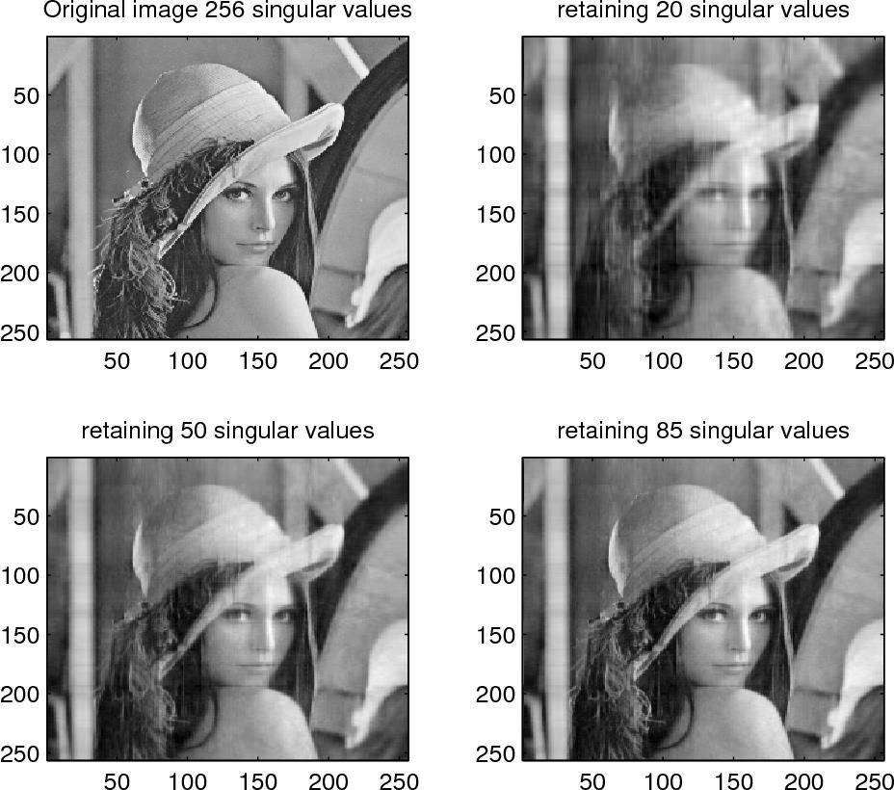
SVD application

Slide 53
Questions?
Sources for this lecture include materials from works by Abhijit Mahalanobis and Fei Fei Li

